Slide 1
Tier Vocabulary
FUNNY & SERIOUS

Slide 2
FUNNY

Slide 3
FUNNY
WHIMSICAL:
Usual in a playful or amusing way

Slide 4
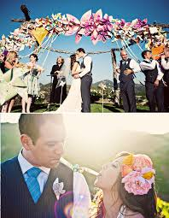
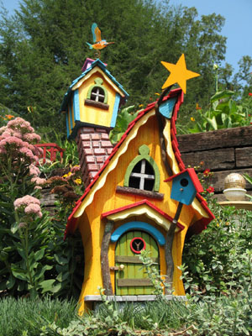

Slide 5
FUNNY
FACETIOUS:
Used to describe speech that is meant to be funny but that is usually regarded as annoying, silly, or not proper.

Slide 6
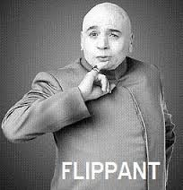
FUNNY
FLIPPANT:
Lacking proper respect or seriousness
Ex. “He made a flippant response to a serious questions.”

Slide 7
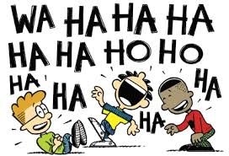
FUNNY
UPROARIOUS:
Very noisy and full
Ex. Uproarious laughter

Slide 8
SERIOUS

Slide 9
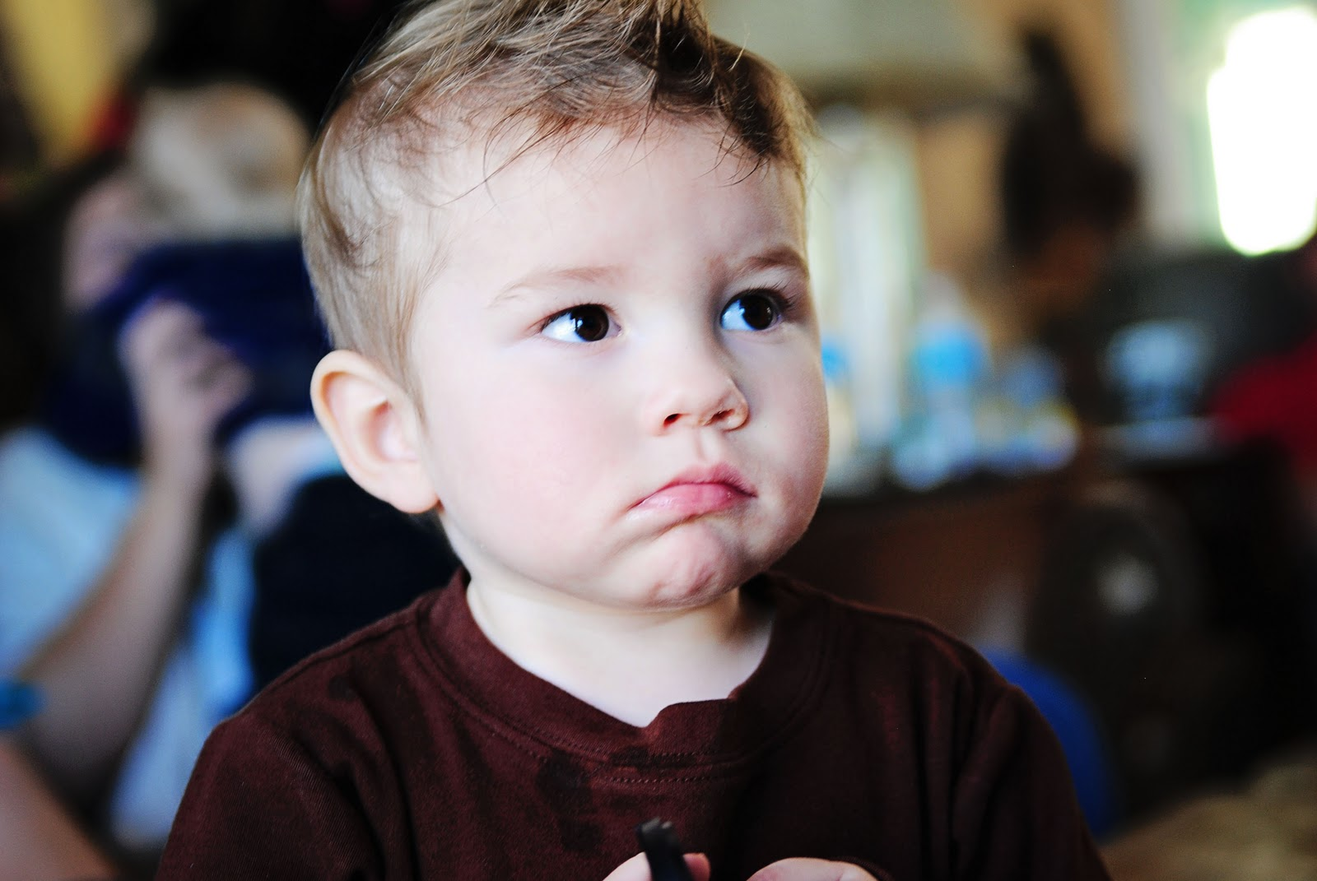
SERIOUS
SOLEMN:
Sad and formal in manner, behavior, or expression

Slide 10
SERIOUS
CRUCIAL:
Extremely important

Slide 11
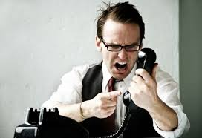
SERIOUS
INTENSE:
Very great in degree; strong; feeling deeply

Slide 12
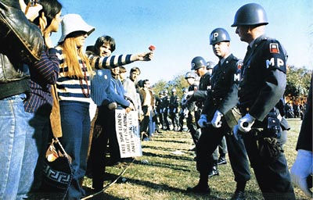
SERIOUS
CONSCIENTIOUS:
Very careful about doing what you are supposed to do; concerned with doing something correctly

